Slide 1
Python programming
unit 3a – function with variable arguments

Slide 2
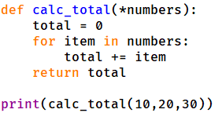
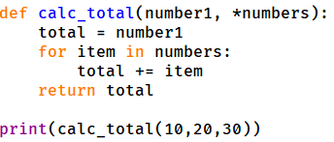
Variable number of arguments
When call the function, all values are packed together (tuple).
Inside function can take all items and use the value.
Variable number arguments must be the last in position.

Slide 3
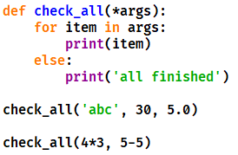
In class practice: what is the result for those code?

Slide 4
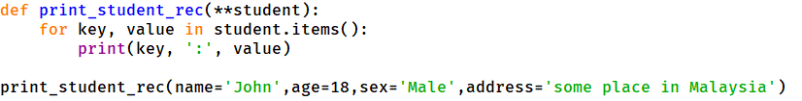
Variable number of named arguments
When call the function, all values are packed together like a dict. Keywords are packed as keys, values are packed as values
Inside function can take all items from the dict and use the key: value pairs.
Variable number arguments must be the last in position.

Slide 5
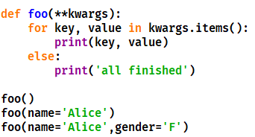
In class practice: what is the result for those code?

Slide 6
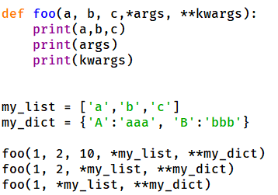
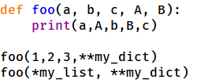
* And ** in function call
* can be used with list or other iterables, to give parameter to variable arguments to a function when doing a function call.
** can be used with dict, to give parameter to keyword variable arguments when doing a function call.

Slide 7
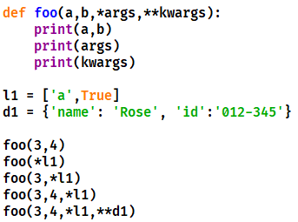
In class practice: what is the result for those code?

Slide 8
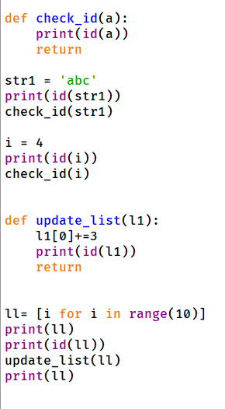
How value passed in function call
Pass by ref:
In python parameter passed like assignment, one more name associated with the data value which is the argument name inside the function.

Slide 9
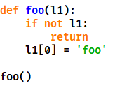
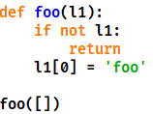
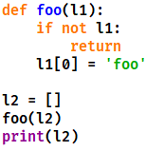
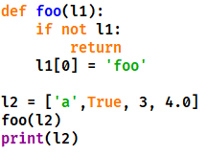
In class practice: what is the result for those code?

